Slide 1
Fundamentals of machine learning 2

Slide 2
Review of fundamental 1
Data mining in 1D: curve fitting by LLS
Approximation-generalization tradeoff
First homework assignment

Slide 3
Review: Concepts from fundamentals 1
Define the following:
Supervised learning
Unsupervised learning
Reinforcement learning
Generalization
Hypothesis set
E_{in}(h|X)
H_{opt} = argmin_{h}(E_{in}(h|X))
E_{out}(h_{opt})
E_{test}(h_{opt})
Version space
Margins
Support vectors

Slide 4
Review: Concepts from fundamentals 1
Define the following:
H shatters N points
VC dimension
Break point
Computations in fundamentals 1
derive MLE expression
constrained optimization by Lagrange multipliers
class specific TR and FR rates from confusion matrix

Slide 5
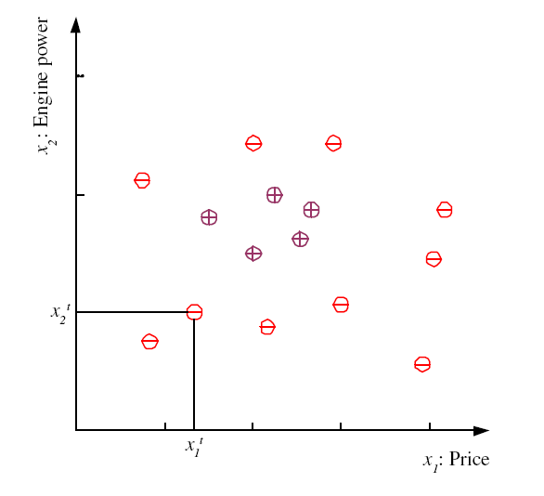
Given 500 family car data points, let x = engine power and y = price.
How do you use these data to find the dependents of price on engine power?
examples of family cars
5
Lecture Notes for E Alpaydın 2010 Introduction to Machine Learning 2e © The MIT Press (V1.0)
Notes:
Χ denotes training set
t is index of training set member
x^{t} is vector of attributes (dimensionality of problem)
r^{t} is label
Label can be either class (classification problem) or real number (regression problem)
This classification problem has only one class (family car) “dichotomizer”
Defined by 2 attributes (price and engine size)
Examples belonging to class are called “positive” and have r = 1
Examples not in class are called “negative” and have r = 0
For some machine learning techniques (SVM) better to assign r = -1 to negative examples
Unsupervised learning: finding attribute space were class members “cluster”

Slide 6
If I interpret my training data as drawn from p(x,y)=p(x)p(y|x),
how do you estimate p(x) and p(y|x)?
examples of family cars
6
Lecture Notes for E Alpaydın 2010 Introduction to Machine Learning 2e © The MIT Press (V1.0)
Notes:
Χ denotes training set
t is index of training set member
x^{t} is vector of attributes (dimensionality of problem)
r^{t} is label
Label can be either class (classification problem) or real number (regression problem)
This classification problem has only one class (family car) “dichotomizer”
Defined by 2 attributes (price and engine size)
Examples belonging to class are called “positive” and have r = 1
Examples not in class are called “negative” and have r = 0
For some machine learning techniques (SVM) better to assign r = -1 to negative examples
Unsupervised learning: finding attribute space were class members “cluster”

Slide 7
Set up a bin structure in the x variable.
Assign the 500 y-values to bins according to their x-value.
What is p(x)? What is p(y|x)?
examples of family cars
7
Lecture Notes for E Alpaydın 2010 Introduction to Machine Learning 2e © The MIT Press (V1.0)
Notes:
Χ denotes training set
t is index of training set member
x^{t} is vector of attributes (dimensionality of problem)
r^{t} is label
Label can be either class (classification problem) or real number (regression problem)
This classification problem has only one class (family car) “dichotomizer”
Defined by 2 attributes (price and engine size)
Examples belonging to class are called “positive” and have r = 1
Examples not in class are called “negative” and have r = 0
For some machine learning techniques (SVM) better to assign r = -1 to negative examples
Unsupervised learning: finding attribute space were class members “cluster”

Slide 8
Set up a bin structure in the x variable.
Assign the 500 y-values to bins according to their x-value.
If I define a new x variable as the bin center, how do I get a
corresponding value of y with error bars
examples of family cars
8
Lecture Notes for E Alpaydın 2010 Introduction to Machine Learning 2e © The MIT Press (V1.0)
Notes:
Χ denotes training set
t is index of training set member
x^{t} is vector of attributes (dimensionality of problem)
r^{t} is label
Label can be either class (classification problem) or real number (regression problem)
This classification problem has only one class (family car) “dichotomizer”
Defined by 2 attributes (price and engine size)
Examples belonging to class are called “positive” and have r = 1
Examples not in class are called “negative” and have r = 0
For some machine learning techniques (SVM) better to assign r = -1 to negative examples
Unsupervised learning: finding attribute space were class members “cluster”

Slide 9
Curve fitting: “regression” in 1D
Regression can have any number of attributes
Label on examples is always a real number

Slide 10
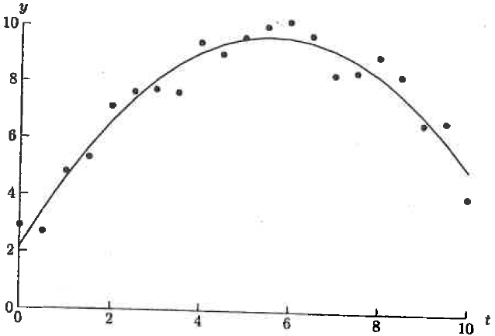
Fit a parabola to data
“target function” is “trend” in the data
Scatter around trend interpreted as noise
H in this case is the set of all 2nd degree polynomials
Select best member of H by min sum squared residuals

Slide 11
Finding the best member of H by calculus
Take derivatives of E_{in}(g) with respect to the coefficients of a parabola (collective call θ ) and set equal to zero.
Solve resulting 3x3 linear system
Generalize to any degree polynomial using a matrix algebra

Slide 12
Polynomial regression by linear least squares
Assume g(x|θ) is polynomial of degree n-1
(i.e linear combination of 1, x, x², …, x^{n-1} )
m = number of examples (x_{i}^{t}, r_{i}^{t}) in the training set
Define mxn matrix A
A_{ij} = j^{th} function in evaluated at x_{i}^{t}
θ column vector of n unknown coefficients
b column vector of m values of r_{i}^{t} in training set
If Aθ = b has a solution, then g(x_{i}^{t}|θ) = r_{i}^{t} for all i
Not what we want, why?
with n << m, Aθ = b has no exact solution
Lecture Notes for E Alpaydın 2010 Introduction to Machine Learning 2e © The MIT Press (V1.0)
12

Slide 13
Normal Equations
Look for an approximate solution which minimizes the Euclidean norm of the residual vector r = b – Aθ,
define f(θ) = ||r||² = r^{T}r
f(θ) = (b – Aθ)^{T}(b – Aθ) = b^{T}b –2θ^{T}A^{T}b + θ^{T}A^{T}Aθ
A necessary condition for θ₀ to be minimum of f(θ) is ∇f(θ₀) = o
∇f(θ) = 2A^{T}Aθ – 2A^{T}b
optimal set of parameters is a solution of nxn symmetric system
of linear equations A^{T}Aθ = A^{T}b
Lecture Notes for E Alpaydın 2010 Introduction to Machine Learning 2e © The MIT Press (V1.0)
13

Slide 14
Polynomial Regression: degree k with N data points
Solve D^{T}Dw = D^{T}r for k+1 coefficients
Lecture Notes for E Alpaydın 2010 Introduction to Machine Learning 2e © The MIT Press (V1.0)

Slide 15
Given the parameters that minimize the sum of squared deviations,
are the values of the fit at x^{t}, the locations data points,
and R = Y_{fit} – Y are the residuals at the data points
Lecture Notes for E Alpaydın 2010 Introduction to Machine Learning 2e © The MIT Press (V1.0)

Slide 16
Coefficient of determination
Denominator is the sum of squared error associated with
the hypothesis that data is approximated by its mean value,
a polynomial of degree zero
Lecture Notes for E Alpaydın 2010 Introduction to Machine Learning 2e © The MIT Press (V1.0)
16

Slide 17
Review
1D polynomial regression (curve fitting) has all of the
fundamental characteristics of data mining
Data points (x, y) support supervised machine learning with
x as the attribute and y as the label
The degree of the polynomial defines an hypothesis set
Polynomials of higher degree are more complex hypotheses.
Sum of squared residuals defines an E_{in} that can be used to
select a member of the hypothesis set by matrix algebra.
E_{out} can be analytically defined and calculated for in silico
datasets (target function + noise)

Slide 18
Tuning regression models
The degree of the polynomial used in fitting data by polynomials is an
example of complexity in the hypothesis set H used in data mining.
As degree increases the hypothesis set has more adjustable parameters;
hence, a greater diversity of shapes is possible.

Slide 19
Over-fitting
Parabolic fit shown here looks OK but would a cubic give a better fit?
Cubic fit will give a smaller E_{in}(g) but likely at the cost of a larger E_{out}(g)
Cubic lets me fit more of the noise in the data, which is specific to this
data set
The optimum cubic fit to this data set is likely a poorer approximation
to a different data set because noise is different.

Slide 20
Approximation – Generalization Tradeoff
In the theory of generalization (covered fundaments 3) it can be shown that
E_{out}(g) < E_{in}(g) + Ω(N, H, δ) where Ω is a function of N the training-set size,
H the hypothesis set, and δ the allowable uncertainty in the final model.
Ω(N, H, δ) is a bound on the difference between E_{out}(g) and E_{in}(g)
If Ω(N, H, δ) is small we can be confident of good generalization.
At given complexity (determined by H), higher statistical confidence
(1-δ) can usually be achieved with larger N
At fixed N and δ, Ω usually increases with the complexity of H, making
generalization less certain.
Even though E_{in}(g) may decrease with higher complexity, E_{out}(g) may not.
In least-squares 1D regression, this effect can be illustrated by the
“Bias/Variance dilemma”

Slide 21
Given a parabolic target function, construct several “in silico” data sets by adding noise drawn from a normal distribution with zero mean and a specified variance
Fit a cubic to each in silico data set.
Averaging these results we get a consensus cubic fit
Difference between consensus fit and target function called “bias”
From consensus fit and individual cubic fits, we can calculate a variance

Slide 22
Formal definitions of Bias & Variance
Assume the target function f(x) is known
Create M in silico datasets of size N by adding noise to f(x)
For each dataset find the best g_{i}(x) of given complexity
Average g_{i}(x) to get best overall estimator of f(x)
Calculate bias and variance of best estimator as follows
Lecture Notes for E Alpaydın 2010 Introduction to Machine Learning 2e © The MIT Press (V1.0)
22

Slide 23
Expectation values of E_{out}(g)
is out-of-sample error for i^{th} training set
E_{x} denotes average over the specified domain for f(x).
where < > denotes average over data sets.
E_{out} can be written as sum of 3 terms, σ² + bias² + variance
where σ² is a contribution from noise in the data
σ² does not depend on complexity of the hypothesis set, so we can ignore it in this discussion
Lecture Notes for E Alpaydın 2010 Introduction to Machine Learning 2e © The MIT Press (V1.0)
23

Slide 24
Derive E_{out} = bias² + variance

Slide 25
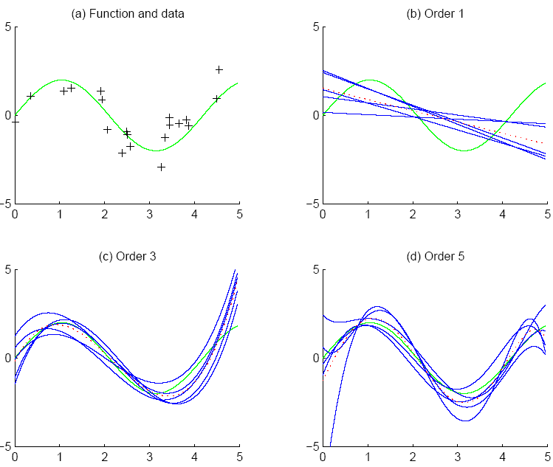
Polynomial fits to sin(x) + noise
f
Bias is RMSD
f
g_{i}
g
one in silico experiment
Linear regression: 5 experiments
Smaller Bias
Larger variance
Each cubic has shape like f(x)
Shape of g_{i} varies more
25

Slide 26
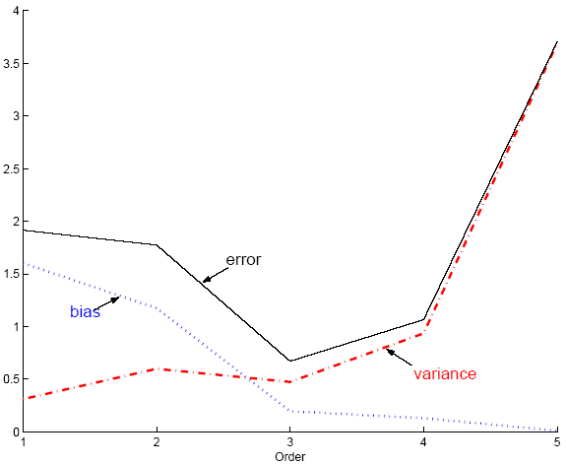
Bias, variance and E_{out} from polynomial fits to sin(x) + noise
Best complexity is degree 3
Beyond 3, decreases in bias are
offset of increases in variance
Lecture Notes for E Alpaydın 2010 Introduction to Machine Learning 2e © The MIT Press (V1.0)
26

Slide 27

Cannot use bias/variance analysis to tune polynomial fits to
real data because f(x) is unknown; hence we cannot calculate
the bias.

Slide 28
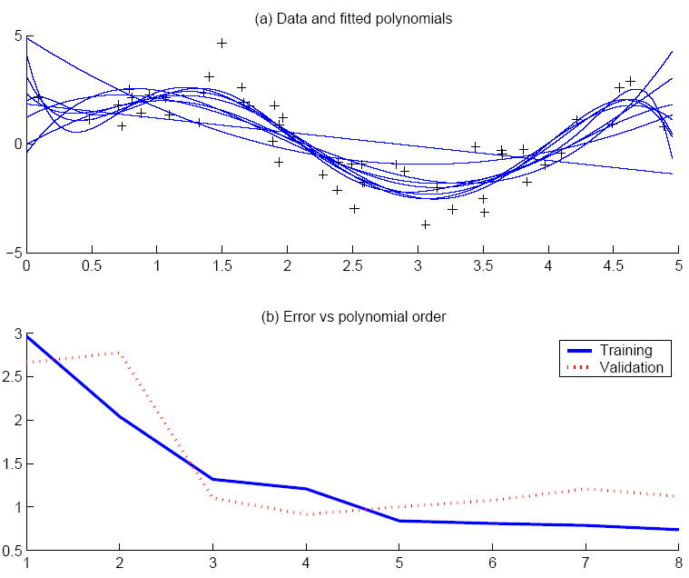
divide real data into training and validation sets
Use validation set to estimate E_{out}
“elbow” in estimate of E_{out} indicates best complexity
Lecture Notes for E Alpaydın 2010 Introduction to Machine Learning 2e © The MIT Press (V1.0)
28

Slide 29
Assignment 1 due 9-18-15
Generate the in silico data set of 2sin(1.5x)+N(0,1) with 100 random values of x between 0 and 5
Use 25 samples for training, 75 for validation
Fit polynomials of degree 1 – 5 to the training set.
Calculate at each degree.
Plot your result as shown in previous slide to find the “elbow” in E_{val} and best complexity for data mining
Use the full data set to find the optimum polynomial of best complexity
Show this result as plot of data and fit on the same set of axes.
Report the minimum sum of squared residuals and coefficient of determination

Slide 30
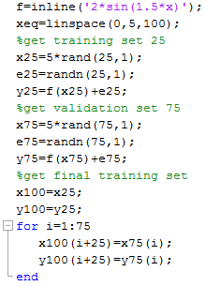
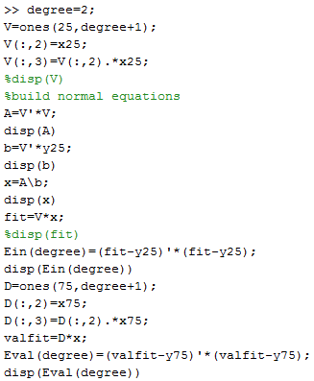
Get in silico data
Calculate in-sample and validation errors

Slide 31
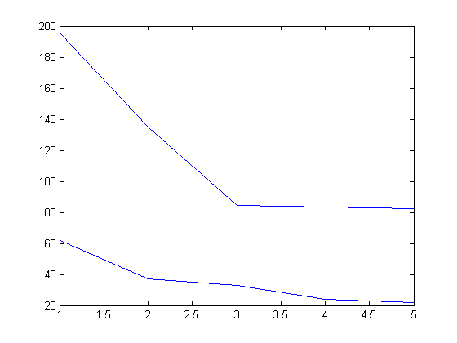
Evidence for cubic as best choice for degree of polynomial
VC bound suggests that small decreases in E_{val} for degree>3 do not indicate better generalization.
E_{in} and E_{val}
Degree of polynomial

Slide 32
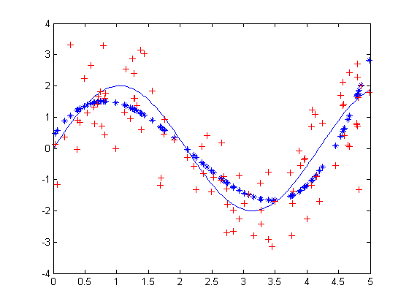
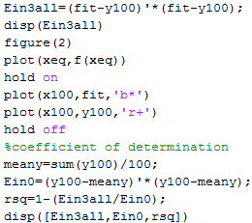
Expected results: solid curve is target function, *’s are cubic fit, +’s are training data

